Slide 1

Python Basic’s
Lecturer: Reza Arjmandi
Summer 2018
Preface:
In this chapter, you will find a host of recipes to help you get programming with Raspberry Pi.

Slide 2
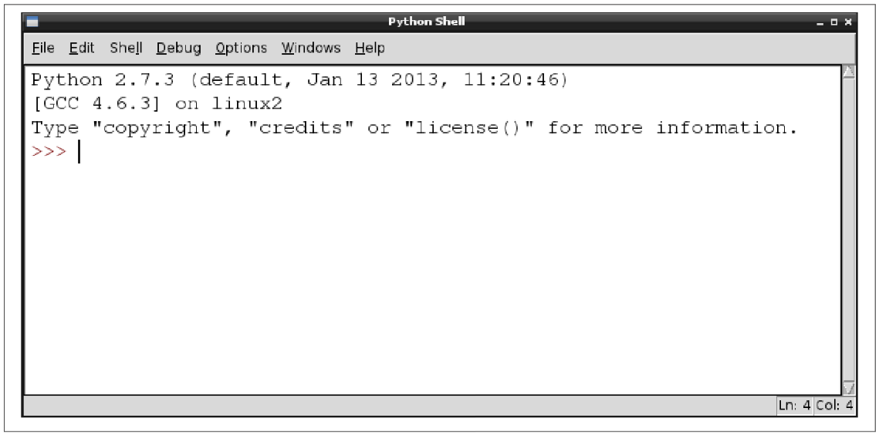
Editing Python Programs with IDLE
The common Raspberry Pi distributions come with the IDLE Python development tool in both the Python 2 and Python 3 versions. If you are using Raspbian , you will find shortcuts to both versions of IDLE on your Raspberry Pi desktop.
This is an interactive area where you can type Python and see the results immediately.

Slide 3
Help In Python
You can use help to access the docstrings of the different modules you have imported, e.g., try the following:
>>> import math
>>> help(math)
………
>>>help(math.sin)
………
For open help center of python:
>>> help(help)
…
Help for modules:
>>> help(“modules”)
…
Help for one module(not required to import):
>>> help(“modules time”)
…

Slide 4
Indentation in Python
Whereas many C-based languages use { and } to delimit a block of code, Python uses the indentation level.
Example:
for i in range(1, 10):
print(i)
in the preceding example, Python knows that print is to be invoked repeatedly as part of the for loop because it is indented out four spaces.
Indenting starts a block and unindenting ends it.
There are no explicit braces, brackets, or keywords. This means that whitespace is significant, and must be consistent.
In this example, the function code is indented four spaces. It doesn’t need to be four spaces, it just needs to be consistent. The first line that is not indented marks the end of the for loop.

Slide 5
Indentation in Python
Python uses carriage returns to separate statements and a colon and indentation to separate code blocks.
C++ and Java use semicolons to separate statements and curly braces to separate code blocks.

Slide 6
Using the Python Console
You want to enter Python commands without writing a whole program.
Use the Python console, either within IDLE (Previous Recipe) or in a Terminal session.
To start a Python 2 console in a Terminal window, just type the command python; for a Python 3 console, enter the command python3.
The >>> prompt indicates that you can type Python commands. If you need to type multiline commands, then the console will automatically provide a continuation line indicated by three dots. You still need to indent any such lines, by four spaces, as shown in the following session:
>>> for i in range(1, 5):
... print(i)
...
1
2
3
4
5

Slide 7
Variables
Assign a value to a name using =.
In Python, you don’t have to declare the type of a variable, you can just assign it a value as shown in the following examples:
Example:
a = 123
b = 12.34
c = "Hello"
d = 'Hello'
e = True
You can define character string constants using either single or double quotes. The logical constants in Python are True and False and are case-sensitive.

Slide 8
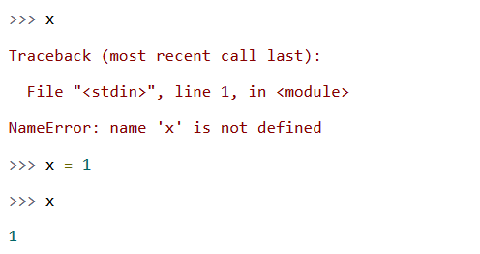
Variables
In Python, variables are never explicitly typed. Python figures out what type a variable is and keeps track of it internally.
In Java and other statically-typed languages, you must specify the datatype of the function return value and each function argument. In Python, you never explicitly specify the datatype of anything. Based on what value you assign, Python keeps track of the datatype internally.
What Python will not let you do is reference a variable that has never been assigned a value. Trying to do so will raise a NameError exception.

Slide 9
Displaying Output
Use the print command. You can try the following example in the Python console
Example:
>>> x = 10
>>> print(x)
10
>>>

Slide 10
Reading User Input
Use the input (Python 3) or raw_input (Python 2) command. You can try the following example in the Python 3 console :
>>> x = input("Enter Value:")
Enter Value:23
>>> print(x)
23
>>>
Python 2 also has an input function, but this validates the input and attempts to convert it into a Python value of the appropriate type, whereas raw_input does the same thing as input in Python 3 and just returns a string.

Slide 11
Arithmetic
The most common operators for arithmetic are +, -, *, and /, which are, respectively, add, subtract, multiply, and divide.
You can also group parts of the expression together with parentheses, as shown in the following example:
>>> tempC = input("Enter temp in C: ")
Enter temp in C: 20
>>> tempF = (int(tempC) * 9) / 5 + 32
>>> print(tempF)
68.0
>>>
Other arithmetic operators include % (modulo remainder) and ** (raise to the power of). For example:
>>> 2 ** 8
256
The Math library has many useful math functions that you can use.

Slide 12
Creating Strings
Use the assignment operator and a string constant to create a new string. You can use either double or single quotation marks around the string, but they must match.
Example:
>>> s = "abc def"
>>> print(s)
abc def
>>>
If you need to include double or single quotes inside a string, then pick the type of quotes that you don’t want to use inside the string as the beginning and end markers of the string. For example:
>>> s = "Isn't it warm?"
>>> print(s)
Isn't it warm?
>>>

Slide 13
Creating Strings
Sometimes you’ll need to include special characters such as tab or newline inside your string. This requires the use of what are called escape characters. To include a tab, use \t, and for a newline, use \n. For example:
>>> s = "name\tage\nMatt\t14"
>>> print(s)
name age
Matt 14
>>>

Slide 14
Concatenating (Joining) Strings
Use the + (concatenate) operator.
Example:
>>> s1 = "abc"
>>> s2 = "def"
>>> s = s1 + s2
>>> print(s)
abcdef
>>>
In many languages, you can have a chain of values to concatenate, some of which are strings and some of which are other types such as numbers; numbers will automatically be converted into strings during the concatenation. This is not the case in Python, and if you try the following command, you will get an error:
>>> "abc" + 23
Traceback (most recent call last): File "<stdin>", line 1, in <module>
TypeError: Can't convert 'int' object to str implicitly

Slide 15
Concatenating (Joining) Strings
You need to convert each component that you want to concatenate to a string before concatenating, as shown in this example:
>>> "abc" + str(23)
'abc23'
>>>

Slide 16
Converting Numbers to Strings
Use the str Python function. For example:
>>> str(123)
'123'
>>>

Slide 17
Converting Strings to Numbers
Use the int or float Python function.
Example:
>>> int("-123")
-123
>>>
To convert a floating-point number, use float instead of int:
>>> float("123.45")
123.45
>>>

Slide 18
Converting Strings to Numbers
You can also use int to convert a string representing a number in a number base other than the default of 10 by supplying the number base as the second argument. The following example converts the string representation of binary 1001 into a number:
>>> int("1001", 2)
9
>>>
This second example converts the hexadecimal number AFF0 to an integer:
>>> int("AFF0", 16)
45040
>>>

Slide 19
Find the Length of a String
Use the len Python function.
For example, to find the length of the string abcdef, you would use:
>>> len("abcdef")
6
>>>
The len command also works on arrays

Slide 20
Find the Position of One String Inside Another
Use the find Python function.
For example, to find the starting position of the string def within the string abcdefghi, you would use:
>>> s = "abcdefghi"
>>> s.find("def")
3
>>>
If the string you’re looking for doesn’t exist in the string being searched, then find returns the value -1.

Slide 21
Extracting Part of a String
Use the Python [:] notation.
For example, to cut out a section from the second character to the fifth character of the string abcdefghi, you would use:
>>> s = "abcdefghi"
>>> s[1:5]
'bcde'
>>>
Note that the character positions start at 0, so a position of 1 means the second character in the string and 5 means the sixth, but the character range is exclusive at the high end, so the letter f is not included in this example.

Slide 22
Extracting Part of a String
The [:] notation is actually quite powerful. You can omit either argument, in which case, the start or end of the string is assumed as appropriate. For example:
>>> s = "abcdefghi"
>>> s[:5]
'abcde'
>>>
and
>>> s = "abcdefghi"
>>> s[3:]
'defghi'
>>>
You can also use negative indices to count back from the end of the string. This can be useful in situations such as when you want to find the three-letter extension of a file, as in the following example:
>>> "myfile.txt"[-3:]
'txt'

Slide 23
Replacing One String of Characters with Another Inside a String
Use the replace function.
For example, to replace all occurrences of X with times, you would use:
>>> s = "It was the best of X. It was the worst of X“
>>> s.replace("X", "times")
'It was the best of times. It was the worst of times'
>>>
The string being searched for must match exactly; that is, the search is case-sensitive and will include spaces.

Slide 24
Converting a String to Upper- or Lowercase
Use the upper or lower function as appropriate.
For example, to convert aBcDe to uppercase, you would use:
>>> "aBcDe".upper()
'ABCDE'
>>>
To convert it to lowercase, you would use:
>>> "aBcDe".lower()
'abcde'
>>>

Slide 25
Converting a String to Upper- or Lowercase
In common with most functions that manipulate a string in some way, upper and lower do not actually modify the string, but rather return a modified copy of the string.
For example, the following code returns a copy of the string s, but note how the original string is unchanged.
>>> s = "aBcDe"
>>> s.upper()
'ABCDE'
>>> s
'aBcDe'
>>>
If you want to change the value of s to be all uppercase, then you need to do the following:
>>> s = "aBcDe"
>>> s = s.upper()
>>> s
'ABCDE'

Slide 26
Running Commands Conditionally
Use the Python if command.
The following example will print the message x is big only if x has a value greater than 100:
>>> x = 101
>>> if x > 100:
... print("x is big")
...
x is big
After the if keyword, there is a condition. This condition often, but not always, compares two values and gives an answer that is either True or False. If it is True, then the subsequent indented lines will all be executed.

Slide 27
Running Commands Conditionally
It is quite common to want to do one thing if a condition is True and something different if the answer is False. In this case, the else command is used with if, as shown in this example:
x = 101
if x > 100:
print("x is big")
else:
print("x is small")
print("This will always print")
You can also chain together a long series of elif conditions. If any one of the conditions succeeds, then that block of code is executed, but none of the other conditions are tried. For example:
x = 90
if x > 100:
print("x is big")
elif x < 10:
print("x is small")
else:
print("x is medium")

Slide 28
Comparing Values
Use one of the comparison operators: <, >, <=, >=, ==, or !=.
Some people prefer to use the <> operator in place of !=. Both work the same
You can test out these commands using the Python console , as shown in the following exchange:
>>> 1 != 2
True
>>> 1 != 1
False
>>> 10 >= 10
True
>>> 10 >= 11
False
>>> 10 == 10
True
>>>

Slide 29
Comparing Values
A common mistake is to use = (set a value) instead of == (double equals) in comparisons.
As well as comparing numbers, you can also compare strings using these comparison operators, for example:
>>> 'aa' < 'ab'
True
>>> 'aaa' < 'aa'
False
The strings are compared lexicographically—that is, in the order that you would find them in a dictionary.
This is not quite correct as, for each letter, the uppercase version of the letter is considered less than the lowercase equivalent.

Slide 30
Logical Operators
You need to specify a complex condition in an if statement.
Use one of the logical operators: and, or, and not.
Example:
>>> x = 17
>>> if x >= 10 and x <= 20:
... print('x is in the middle')
...
x is in the middle

Slide 31
Repeating Instructions an Exact Number of Times
Use the Python for command and iterate over a range.
For example, to repeat a command 10 times, use the following example:
>>> for i in range(1, 11):
... print(i)
...
1
2
3
4
5
6
7
8
9
10
>>>

Slide 32
Repeating Instructions Until Some Condition Changes
Use the Python for command and iterate over a range.
Use the Python while statement. The while statement repeats its nested commands until its condition becomes false. The following example will stay in the loop until the user enters X for exit:
>>> answer = ''
>>> while answer != 'X':
... answer = input('Enter command:')
...
Enter command:A
Enter command:B
Enter command:X
>>>

Slide 33
Breaking Out of a Loop
Use the Python break statement to exit either a while or for loop
Example:
>>> while True:
... answer = input('Enter command:')
... if answer == 'X':
... break
...
Enter command:A
Enter command:B
Enter command:X
>>>

Slide 34
Defining a Function in Python
Create a function that groups together lines of code, allowing it to be called from multiple places.
Creating and then calling function in Python is illustrated in the following example:
def count_to_10():
for i in range(1, 11):
print(i)
count_to_10()
The example function is a little inflexible because it can only count to 10. If we wanted to make it more flexible—so it could count up to any number—then we can include the maximum number as a parameter to the function, as this example illustrates:
def count_to_n(n):
for i in range(1, n + 1):
print(i)
count_to_n(5)

Slide 35
Defining a Function in Python
You can specify a default value for a parameter, and hence have the best of both worlds, as shown in this example:
def count_to_n(n=10):
for i in range(1, n + 1):
print(i)
count_to_n()
If your function needs more than one parameter, perhaps to count between two numbers, then the parameters are separated by commas:
def count(from_num=1, to_num=10):
for i in range(from_num, to_num + 1):
print(i)
count()
count(5)
count(5, 30)

Slide 36
Defining a Function in Python
Furthermore, arguments can be specified in any order by using named arguments.
count(to_num = 100, from_num=10)

Slide 37
Optional Parameters
Suppose the following function decleration:
def approximate_size(size, a_kilobyte_is_1024_bytes=True):
if size < 0:
raise ValueError('number must be non-negative')
multiple = 1024 if a_kilobyte_is_1024_bytes else 1000
for suffix in SUFFIXES[multiple]:
size /= multiple
if size < multiple:
return '{0:.1f} {1}'.format(size, suffix)

Slide 38
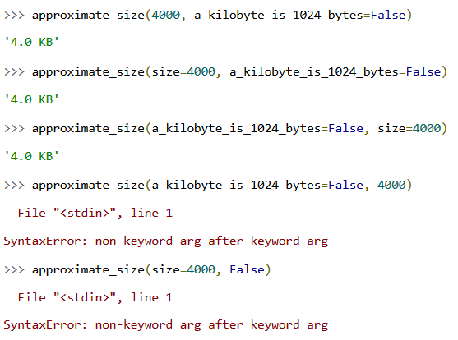
Optional Parameters

Slide 39
Optional Parameters
This fourth function call fails, because you have a named argument followed by an unnamed (positional) argument, and that never works. Reading the argument list from left to right, once you have a single named argument, the rest of the arguments must also be named.

Slide 40
Defining a Function in Python
If you need a function to return a value, you need to use the return command.
def make_polite(sentence):
return sentence + " please“
print(make_polite("Pass the cheese"))

Slide 41
Defining a Function in Python
Python functions do not specify the datatype of their return value; they don’t even specify whether or not they return a value.
In fact, every Python function returns a value; if the function ever executes a return statement, it will return that value, otherwise it will return None, the Python null value.

Slide 42
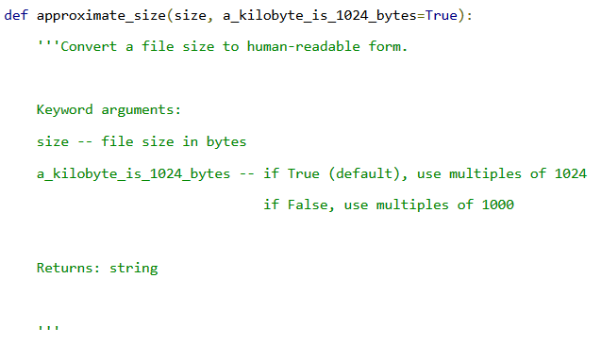
Documentation Strings
You can document a Python function by giving it a documentation string (docstring for short). In this program, the approximate_size() function has a docstring:

Slide 43
Documentation Strings
Triple quotes signify a multi-line string. Everything between the start and end quotes is part of a single string, including carriage returns, leading white space, and other quote characters. You can use them anywhere, but you’ll see them most often used when defining a docstring.
Everything between the triple quotes is the function’s docstring, which documents what the function does. A docstring, if it exists, must be the first thing defined in a function (that is, on the next line after the function declaration). You don’t technically need to give your function a docstring, but you always should. I know you’ve heard this in every programming class you’ve ever taken, but Python gives you an added incentive: the docstring is available at runtime as an attribute of the function

Slide 44
Using Modules
Use the import command:
import random
Standard Python libraries include modules for random numbers, database access, various Internet protocols, object serialization, and many more.
One consequence of having so many modules is that there is the potential for conflict —for example, if two modules have a function of the same name. To avoid such conflicts, when importing a module, you can specify how much of the module is accessible.
For example, if you just use a command like this:
import random
there is no possibility of any conflicts because you will only be able to access any functions or variables in the module by prefixing them with random..

Slide 45
Using Modules
If, on the other hand, you use the following command, everything in the module will be accessible without your having to put anything in front of it.
from random import *
In between these two extremes, you can explicitly specify those components of a module that you need within a program so that they can be conveniently used without any prefix.
Example:
>>> from random import randint
>>> print(randint(1,6))
2
>>>
A third option is to use the as keyword to provide a more convenient or meaningful name for the module when referencing it.
>>> import random as R
>>> R.randint(1, 6)

Slide 46
Random Numbers
You need to generate a random number between a range of numbers.
Use the random library:
>>> import random
>>> random.randint(1, 6)
2
>>> random.randint(1, 6)
6
>>> random.randint(1, 6)
5
A common use of random numbers is to select something at random from a list. You can do this by generating an index position and using that, but there is also a command in the random module specifically for this. Try out the following example:
>>> import random
>>> random.choice(['a', 'b', 'c'])
'a'

Slide 47
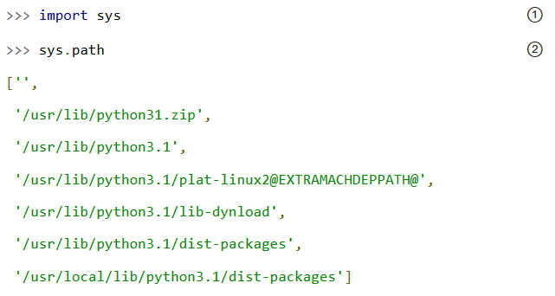
The import Search Path
Python looks in several places when you try to import a module.
Specifically, it looks in all the directories defined in sys.path. This is just a list, and you can easily view it or modify it with standard list methods.

Slide 48
The import Search Path
Python looks in several places when you try to import a module.
Specifically, it looks in all the directories defined in sys.path. This is just a list, and you can easily view it or modify it with standard list methods.
② sys.path is a list of directory names that constitute the current search path. (Yours will look different, depending on your operating system, what version of Python you’re running, and where it was originally installed.) Python will look through these directories (in this order) for a .py file whose name matches what you’re trying to import.

Slide 49
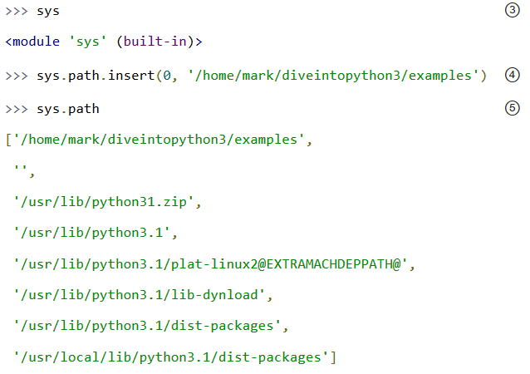
The import Search Path

Slide 50
The import Search Path
③ Actually, I lied; the truth is more complicated than that, because not all modules are stored as .py files.
Some are built-in modules; they are actually baked right into Python itself.
Built-in modules behave just like regular modules, but their Python source code is not available, because they are not written in Python! (Like Python itself, these built-in modules are written in C.)
⑤ By using sys.path.insert(0, new_path), you inserted a new directory as the first item of the sys.path list, and therefore at the beginning of Python’s search path.
This is almost always what you want. In case of naming conflicts (for example, if Python ships with version 2 of a particular library but you want to use version 3), this ensures that your modules will be found and used instead of the modules that came with Python.

Slide 51
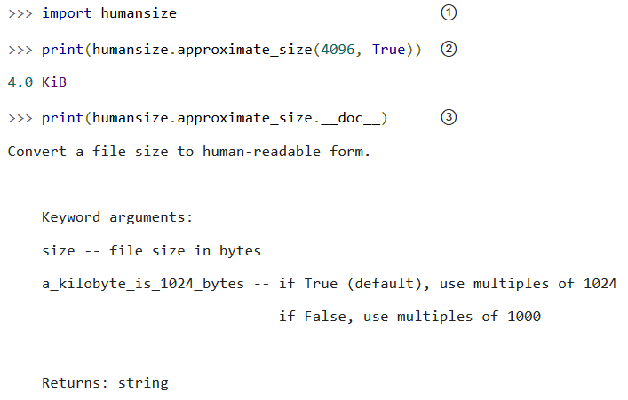
Everything Is An Object
In case you missed it, I just said that Python functions have attributes, and that those attributes are available at runtime. A function, like everything else in Python, is an object.
Run the interactive Python shell and follow along:

Slide 52
Everything Is An Object
① The first line imports the humansize program as a module — a chunk of code that you can use interactively, or from a larger Python program.
Once you import a module, you can reference any of its public functions, classes, or attributes.
Modules can do this to access functionality in other modules, and you can do it in the Python interactive shell too. This is an important concept.
Everything in Python is an object, and everything can have attributes and methods. All functions have a built-in attribute __doc__, which returns the docstring defined in the function’s source code.
The sys module is an object which has (among other things) an attribute called path. And so forth.

Slide 53
what is an object?
Still, this doesn’t answer the more fundamental question: what is an object? Different programming languages define “object” in different ways. In some, it means that all objects must have attributes and methods; in others, it means that all objects are subclassable. In Python, the definition is looser. Some objects have neither attributes nor methods, but they could. Not all objects are subclassable. But everything is an object in the sense that it can be assigned to a variable or passed as an argument to a function.
You may have heard the term “first-class object” in other programming contexts. In Python, functions are first-class objects. You can pass a function as an argument to another function.
Modules are first-class objects. You can pass an entire module as an argument to a function.
Classes are first-class objects, and individual instances of a class are also first-class objects.
Strings are objects. Lists are objects. Functions are objects. Classes are objects. Class instances are objects. Even modules are objects.

Slide 54
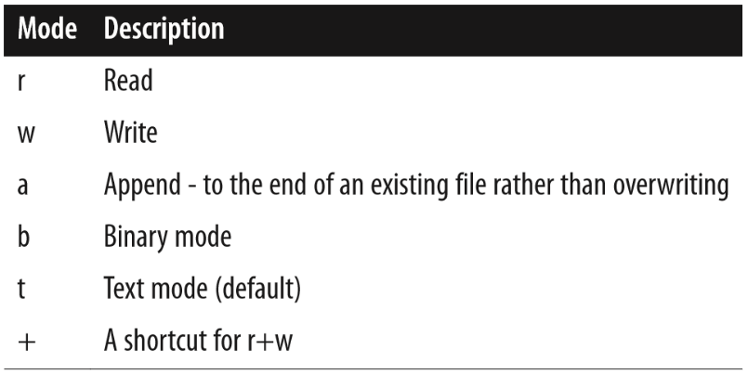
Writing to a File
Use the open, write, and close functions to open a file, write some data, and then close the file, respectively:
>>> f = open('test.txt', 'w')
>>> f.write('This file is not empty')
>>> f.close()
The open method takes two parameters. The first is the path to the file to be written. This can be relative to the current working directory, or if it starts with a /, an absolute path.
The second parameter is the mode in which the file should be opened. To overwrite an existing file, or create the file with the name specified if it doesn’t exist, just use w.
>>> f = open('test.txt', 'r+b')
Binary mode allows you to read or write binary streams of data, such as images, rather than text.

Slide 55
Reading from a File
To read a file’s contents, you need to use the file methods open, read, and close. The following example reads the entire contents of the file into the variable s:
f = open('test.txt')
s = f.read()
f.close()
You can also read text files one line at a time using the method readline.
The preceding example will throw an exception if the file does not exist or is not readable for some other reason. You can handle this by enclosing the code in a try/except construction like this:
try:
f = open('test.txt')
s = f.read()
f.close()
except IOError:
print("Cannot open the file")

Slide 56
Handling Exceptions
If something goes wrong while a program is running, you want to catch the error or exception and display a more user-friendly error message.
Use Python’s try/except construct.
try:
f = open('test.txt')
s = f.read()
f.close()
except IOError:
print("Cannot open the file")
A common situation where runtime exceptions can occur—in addition to during file access—is when you are accessing a list and the index you are using is outside the bounds of the list. For example, this happens if you try to access the fourth element of a three element list:
>>> list = [1, 2, 3]
>>> list[4]
Traceback (most recent call last):
File "<stdin>", line 1, in <module>
IndexError: list index out of range

Slide 57
Handling Exceptions
Exception is pretty near the top of that tree and will catch almost any exception. You can also have separate except sections for catching different types of exception and handling each in a different way. If you do not specify any exception class, all exceptions will be caught.
Python also allows you to have else and finally clauses in your error handling:
list = [1, 2, 3]
try:
list[8]
except:
print("out of range")
else:
print("in range")
finally:
print("always do this")
The else clause will be run if there is no exception, and the finally clause will be run whether there is an exception or not.

Slide 58
Handling Exceptions
Whenever an exception occurs, you can get more information about it using the exception object, which is available only if you use the as keyword, as shown in the following example:
>>> list = [1, 2, 3]
>>> try:
... list[8]
... except Exception as e:
... print("out of range")
... print(e)
...
out of range list index out of range
>>>

Slide 59
Handling Exceptions
Python uses try...except blocks to handle exceptions, and the raise statement to generate them. Java and C++ use try...catch blocks to handle exceptions, and the throw statement to generate them.
You don’t need to handle an exception in the function that raises it. If one function doesn’t handle it, the exception is passed to the calling function, then that function’s calling function, and so on “up the stack.”
If the exception is never handled, your program will crash, Python will print a “traceback” to standard error, and that’s the end of that. Again, maybe that’s what you want; it depends on what your program does.

Slide 60
Raise Exceptions
...
...
if size < 0:
raise ValueError('number must be non-negative')
The syntax for raising an exception is simple enough. Use the raise statement, followed by the exception name, and an optional human-readable string for debugging purposes.
The syntax is reminiscent of calling a function. (In reality, exceptions are implemented as classes, and this raise statement is actually creating an instance of the ValueError class and passing the string 'number must be non-negative' to its initialization method.)

Slide 61
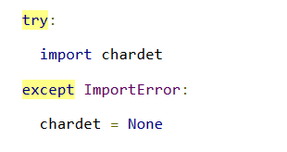
Catching Import Errors
One of Python’s built-in exceptions is ImportError, which is raised when you try to import a module and fail.
This can happen for a variety of reasons, but the simplest case is when the module doesn’t exist in your import search path.
You can use this to include optional features in your program. For example, the chardet library provides character encoding auto-detection. Perhaps your program wants to use this library if it exists, but continue gracefully if the user hasn’t installed it. You can do this with a try..except block.

Slide 62
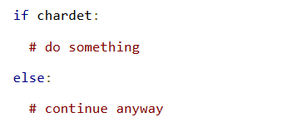
Catching Import Errors
Later, you can check for the presence of the chardet module with a simple if statement:

Slide 63
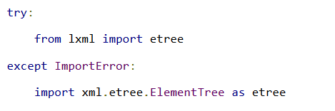
Catching Import Errors
Another common use of the ImportError exception is when two modules implement a common API, but one is more desirable than the other. (Maybe it’s faster, or it uses less memory.)
You can try to import one module but fall back to a different module if the first import fails.
For example, the XML chapter talks about two modules that implement a common API, called the ElementTree API. The first, lxml, is a third-party module that you need to download and install yourself. The second, xml.etree.ElementTree, is slower but is part of the Python 3 standard library.
By the end of this try..except block, you have imported some module and named it etree. Since both modules implement a common API, the rest of your code doesn’t need to keep checking which module got imported. And since the module that did get imported is always called etree, the rest of your code doesn’t need to be littered with if statements to call differently-named modules.

Slide 64
Running Python Programs from the Terminal
Running programs from within IDLE is fine, but sometimes you want to run a Python program from a Terminal window.
Use the python or python3 command in a Terminal, followed by the filename containing the program you want to run.
Example:
$ python myprogram.py
You can run most Python programs as a normal user; however, there are some, especially those that use the GPIO port, that you need to run as super user.

Slide 65
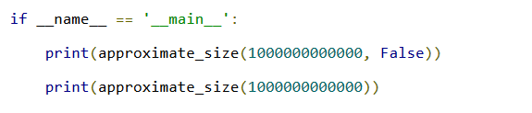
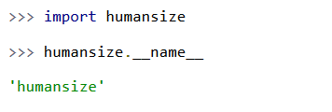
Running Scripts
Python modules are objects and have several useful attributes. You can use this to easily test your modules as you write them, by including a special block of code that executes when you run the Python file on the command line. Take the last few lines of humansize.py:
So what makes this if statement special? Well, modules are objects, and all modules have a built-in attribute __name__. A module’s __name__ depends on how you’re using the module. If you import the module, then __name__ is the module’s filename, without a directory path or file extension.

Slide 66
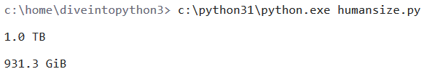
Running Scripts
But you can also run the module directly as a standalone program, in which case __name__ will be a special default value, __main__
Python will evaluate this if statement, find a true expression, and execute the if code block. In this case, to print two values.

Slide 67
Python DataType
In Python, every value has a datatype, but you don’t need to declare the datatype of variables.
How does that work?
Based on each variable’s original assignment, Python figures out what type it is and keeps tracks of that internally.

Slide 68
Python DataType
Python has many native datatypes. Here are the important ones:
Booleans are either True or False.
Numbers can be integers (1 and 2), floats (1.1 and 1.2), fractions (1/2 and 2/3), or even complex numbers.
Strings are sequences of Unicode characters, e.g. an HTML document.
Bytes and byte arrays, e.g. a JPEG image file.
Lists are ordered sequences of values.
Tuples are ordered, immutable sequences of values.
Sets are unordered bags of values.
Dictionaries are unordered bags of key-value pairs.

Slide 69
Python DataType
Of course, there are more types than these.
Everything is an object in Python, so there are types like module, function, class, method, file, and even compiled code. You’ve already seen some of these: modules have names, functions have docstrings,

Slide 70
Booleans
Booleans are either true or false. Python has two constants, cleverly named True and False, which can be used to assign boolean values directly.
Expressions can also evaluate to a boolean value. In certain places (like if statements), Python expects an expression to evaluate to a boolean value. These places are called boolean contexts.
You can use virtually any expression in a boolean context, and Python will try to determine its truth value. Different datatypes have different rules about which values are true or false in a boolean context. (This will make more sense once you see some concrete examples later in this chapter.)

Slide 71
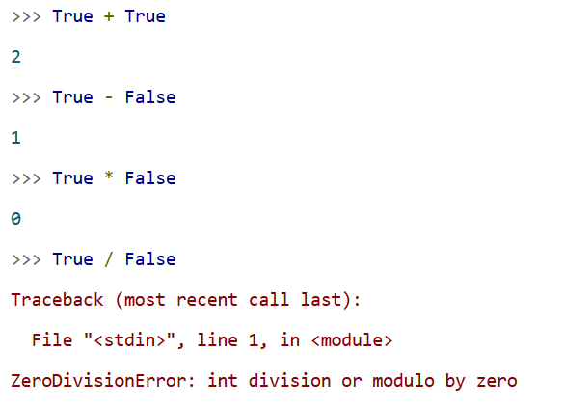
Booleans
Due to some legacy issues left over from Python 2, booleans can be treated as numbers. True is 1; False is 0.

Slide 72
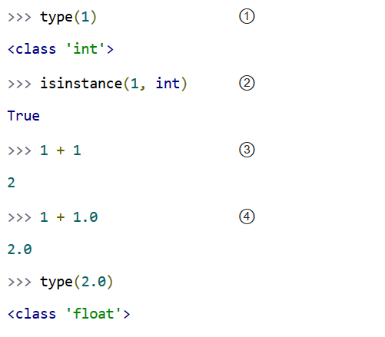
Numbers
Numbers are awesome. There are so many to choose from. Python supports both integers and floating point numbers. There’s no type declaration to distinguish them; Python tells them apart by the presence or absence of a decimal point.

Slide 73
Numbers
① You can use the type() function to check the type of any value or variable. As you might expect, 1 is an int.
② Similarly, you can use the isinstance() function to check whether a value or variable is of a given type.
③ Adding an int to an int yields an int.
④ Adding an int to a float yields a float. Python coerces the int into a float to perform the addition, then returns a float as the result.

Slide 74
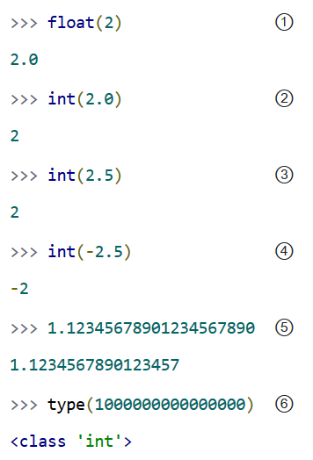
Coercing Integers To Floats And Vice-Versa
As you just saw, some operators (like addition) will coerce integers to floating point numbers as needed. You can also coerce them by yourself.
 | The int() function will truncate, not round.
Floating point numbers are accurate to 15 decimal places
Integers can be arbitrarily large.

Slide 75
Coercing Integers To Floats And Vice-Versa
As you just saw, some operators (like addition) will coerce integers to floating point numbers as needed. You can also coerce them by yourself.
 | The int() function will truncate, not round.
Floating point numbers are accurate to 15 decimal places
Integers can be arbitrarily large.

Slide 76
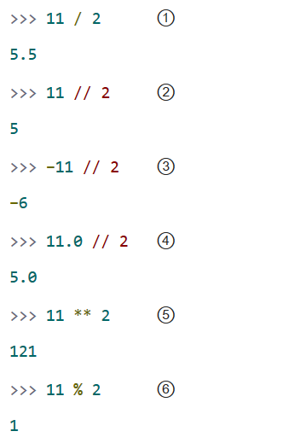
Common Numerical Operations
You can do all kinds of things with numbers.

Slide 77
Common Numerical Operations
① The / operator performs floating point division. It returns a float even if both the numerator and denominator are ints.
② The // operator performs a quirky kind of integer division. When the result is positive, you can think of it as truncating (not rounding) to 0 decimal places, but be careful with that.
③ When integer-dividing negative numbers, the // operator rounds “up” to the nearest integer. Mathematically speaking, it’s rounding “down” since −6 is less than −5, but it could trip you up if you were expecting it to truncate to −5.
④ The // operator doesn’t always return an integer. If either the numerator or denominator is a float, it will still round to the nearest integer, but the actual return value will be a float.
⑤ The ** operator means “raised to the power of.”
⑥ The % operator gives the remainder after performing integer division. 11 divided by 2 is 5 with a remainder of 1, so the result here is 1.

Slide 78
Common Numerical Operations
In Python 2, the / operator usually meant integer division, but you could make it behave like floating point division by including a special directive in your code.
In Python 3, the / operator always means floating point division.

Slide 79
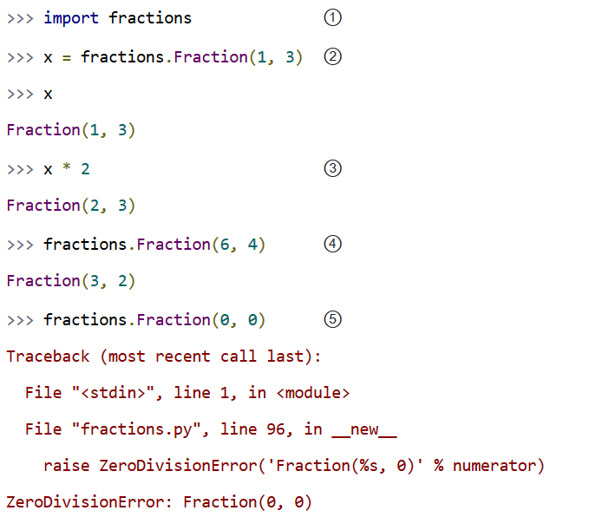
Fractions
Python isn’t limited to integers and floating point numbers. It can also do all the fancy math you learned in high school and promptly forgot about.

Slide 80
Common Numerical Operations
① To start using fractions, import the fractions module.
② To define a fraction, create a Fraction object and pass in the numerator and denominator.
③ You can perform all the usual mathematical operations with fractions. Operations return a new Fraction object. 2 * (1/3) = (2/3)
④ The Fraction object will automatically reduce fractions. (6/4) = (3/2)
⑤ Python has the good sense not to create a fraction with a zero denominator.

Slide 81
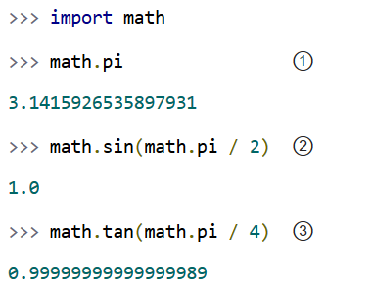
Trigonometry
You can also do basic trigonometry in Python.

Slide 82
Trigonometry
① The math module has a constant for π, the ratio of a circle’s circumference to its diameter.
② The math module has all the basic trigonometric functions, including sin(), cos(), tan(), and variants like asin().
③ Note, however, that Python does not have infinite precision. tan(π / 4) should return 1.0, not 0.99999999999999989.

Slide 83
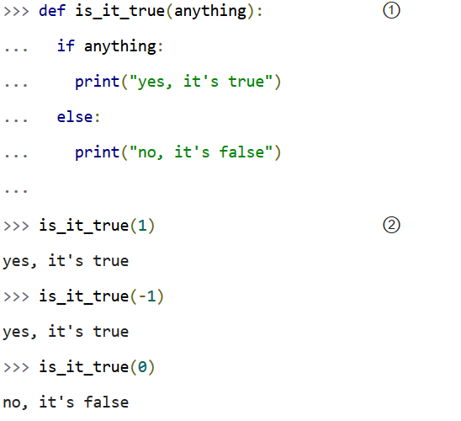
Numbers In A Boolean Context
You can use numbers in a boolean context, such as an if statement. Zero values are false, and non-zero values are true.

Slide 84
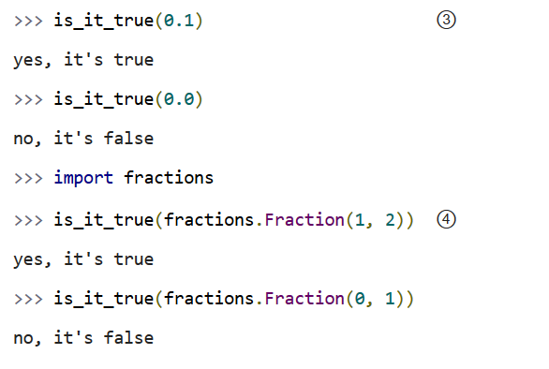
Numbers In A Boolean Context
③ Non-zero floating point numbers are true; 0.0 is false. Be careful with this one! If there’s the slightest rounding error (not impossible, as you saw in the previous section) then Python will be testing 0.0000000000001 instead of 0 and will return True.
④ Fractions can also be used in a boolean context. Fraction(0, n) is false for all values of n. All other fractions are true.

Slide 85


Contact us
www.e-system.ir
Info@e-system.ir

